Slide 1
Introduction to Arduino Programming
Course Instructor: Tejas S Shah

Slide 2

Contents
Introduction to Arduino
Concise Introduction to Electronics
Hardware Architecture
Setting-up Autodesk TinkerCAD
Recommended Reading (Sensors) - Homework

Slide 3
Introduction to Arduino
Arduino is an open-source platform used for building electronics projects.
Arduino consists of both a physical programmable circuit board (often referred to as a microcontroller) and a piece of software, or IDE (Integrated Development Environment), used to write and upload computer code to the physical board.
Arduino boards can read inputs - light on a sensor, a finger on a button, or a Twitter message - and turn it into an output - activating a motor, turning on an LED, publishing something online. You can tell your board what to do by sending a set of instructions to the microcontroller on the board.

Slide 4
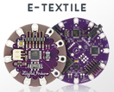
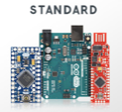
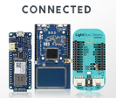
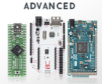
Types

Slide 5
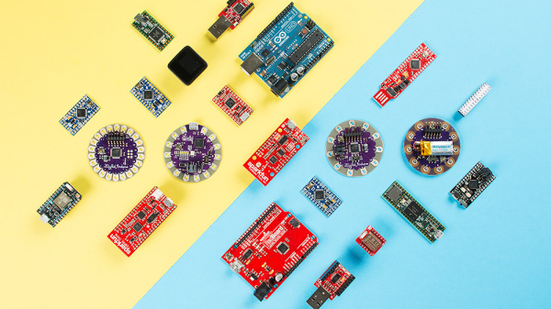

Slide 6
Applications
Robotics (Robotic arm, Hexapod Robot, etc.)
Automation (Home automation, Automatic watering, etc.)
Industrial (CNC Machine, Vending Machine, etc.)
Healthcare (Medical devices)
Wireless (Sensor networks, Wireless Weather Station)
Entertainment (Gaming console, Music Player and Alarm Clock)
Security (RFID-based Security, Fingerprint based Security)
Reference: https://howtomechatronics.com/arduino-projects/

Slide 7
Basics of Electronic Devices
Fuse
Pushbutton
Relay
Potentiometer
DC-DC converter
DC Motor

Slide 8
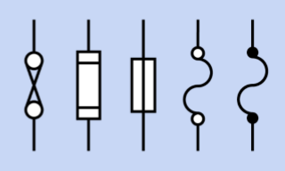
Fuse
A fuse protects an electrical circuit or device from excessive current when a metal element inside it melts to create an open circuit.
Except for resettable fuses, a fuse must be discarded and replaced after it has fulfilled its function. When high current melts a fuse, it is said to blow or trip the fuse.
A fuse can work with either AC or DC voltage and can be designed for almost any current.

Slide 9
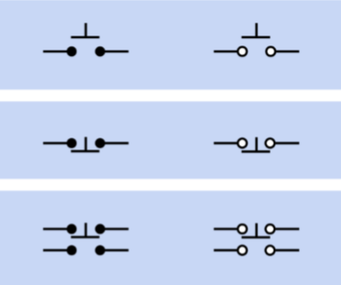
Pushbutton
A pushbutton contains at least two contacts, which close or open when the button is pressed. Usually a spring restores the button to its original position when external pressure is released.
Unlike a switch, a basic pushbutton does not have a primary contact that can be identified as the pole.

Slide 10
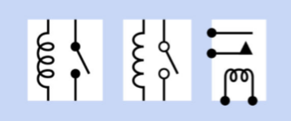
Relay
A relay enables a signal or pulse of electricity to switch on (or switch off) a separate flow of electricity. Often, a relay uses a low voltage or low current to control a higher voltage and/or higher current.
The low voltage/low current signal can be initiated by a relatively small, economical switch, and can be carried to the relay.
In a car, for example, turning the ignition switch sends a signal to a relay positioned close to the starter motor.

Slide 11
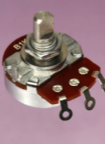
Potentiometer
When a voltage is applied across a potentiometer, it can deliver a variable fraction of that voltage. It is often used to adjust sensitivity, balance, input, or output, especially in audio equipment and sensors such as motion detectors.
A potentiometer can also be used to insert a variable resistance in a circuit, in which case it should really be referred to as a variable resistor, although most people will still call it a potentiometer.

Slide 12
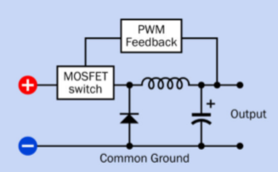
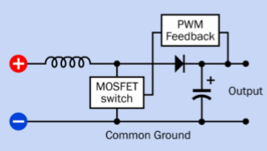
DC – DC Converter
Buck Converter
Boost Converter
The output voltage is lower than the input voltage. The input and output share a common ground. For this circuit: Vout = Vin * D
The output voltage is greater than the input voltage. The input and output share a common ground. For this circuit: Vout = Vin / (1-D)

Slide 13
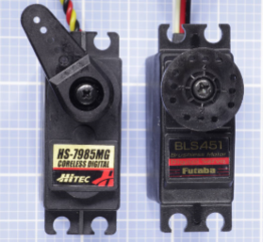
Servo Motor
A servo motor is a combination of a motor, reduction gearing, and miniaturized control electronics, usually packaged together inside a very compact sealed plastic case.
The motor itself may be AC or DC, and if DC, it may be brushed or brushless.
What distinguishes a servo from other types of motor is that it is not designed for continuous rotation.

Slide 14
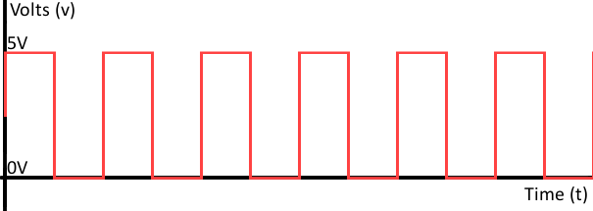
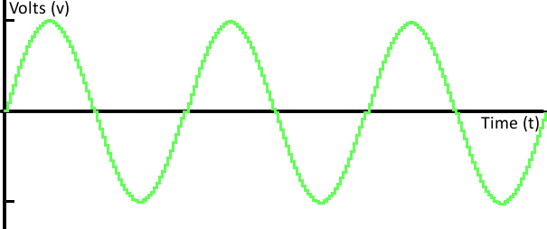
Basic Signals
Digital Signal
Analog Signal
Most commonly digital signals will be one of two values -- like either 0V or 5V. Timing graphs of these signals look like square waves.
Analog Signal is smooth and consists of a variety of values. Most signals obtained from sensors are Analog.

Slide 15
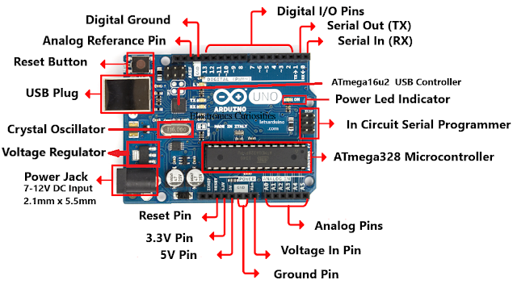
What's on the board?

Slide 16
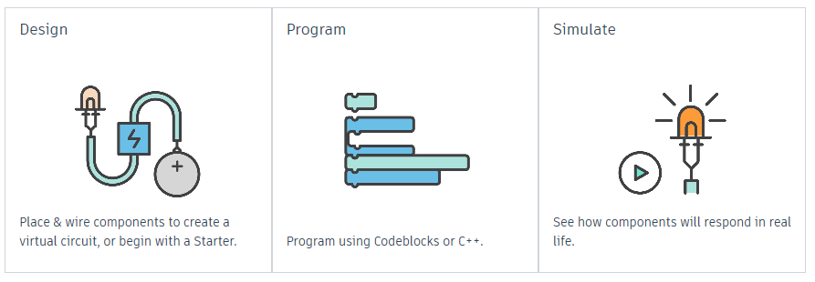
TinkerCAD - Circuits
Go to: www.tinkercad.com

Slide 17
Thank You
End of Day-1. Questions?

